Slide 1

Beyond CS106A
Chris Piech
CS106A, Stanford University

Slide 3


Four Prototypical Trajectories
Life after ACM

Slide 4
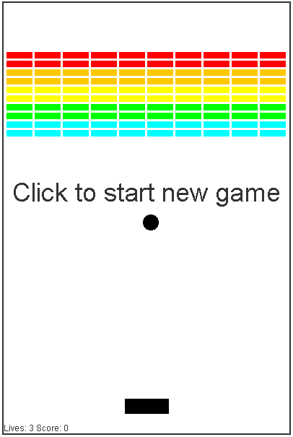

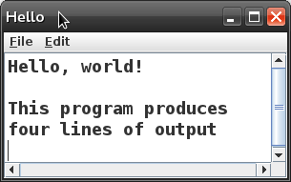
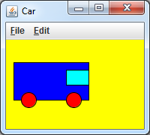
Life After The ACM Libraries
All quarter we have relied on the ACM Java libraries.
Karel, ConsoleProgram, RandomGenerator
GraphicsProgram, GOval, GRect, GOval, GLine, GImage, ...
Today we will see how standard Java programs are made.

Slide 5
Using the ACM Libraries
import acm.program.*;
public class MyProgram extends ConsoleProgram {
public void run() {
println("Hello, world!");
}
}
This is a console program written using the ACM libraries.
It uses the ConsoleProgram class to represent a console.
The run method contains the program code.
The println method prints output to the graphical console.

Slide 6
A Barebones Java Program
public class Hello {
public static void main(String[] args) {
System.out.println("Hello, world!");
}
}
The method main is the true entry point for a Java program.
It must have the exact heading shown above.
The String[] args are "command line arguments" (ignored).
The println command's true name is System.out.println.
Standard Java methods are static unless part of a class of objects.

Slide 7
Four Prototypical Trajectories
Lets make Hello World!

Slide 8
Console Programs
What does the ConsoleProgram library class do?
Creates a new graphical window
Puts a scrollable text area into it
Provides print and println commands to send text output to that window
contains a main method that calls your program class's run method
ConsoleProgram's run is empty, but you extend and override it
public class Hello extends ConsoleProgram {
public void run() {
println("Hello, world!");
}
}

Slide 9
ACM console input
public class Age extends ConsoleProgram {
public void run() {
String name = readLine("What's your name? ");
int age = readInt("How old are you? ");
int years = 65 - age;
println(name + " has " + years
+ " years until retirement!");
}
}
The ACM library has simple console input commands like readLine, readInt, readDouble, and so on.
These methods display a 'prompt' message, wait for input, re-prompt if the user types a bad value, and return the input.

Slide 10
Java console input
public class Age {
public static void main(String[] args) {
Scanner console = new Scanner(System.in);
System.out.print("What's your name? ");
String name = console.nextLine();
System.out.print("How old are you? ");
int age = console.nextInt();
int years = 65 - age;
System.out.println(name + " has " + years
+ " years until retirement!");
}
}
In standard Java, you must create a Scanner or similar object to read input from the console, which is also called System.in.
It does not automatically re-prompt and can crash on bad input.

Slide 11
Graphics Programs
The ACM library does several things to make graphics easier:
Automatically creates and displays a window on the screen.
In standard Java, we must do this ourselves; it is called a JFrame.
Sets up a drawing canvas in the center of the window In standard Java, we must create our own drawing canvas.
Provides convenient methods to listen for mouse events.
In standard Java, event handling takes a bit more code to set up.

Slide 12
ACM GUI example
public class ColorFun extends Program {
public void init() {
JButton button1 = new JButton("Red!");
JButton button2 = new JButton("Blue!");
add(button1, SOUTH);
add(button2, SOUTH);
addActionListeners();
}
public void actionPerformed(ActionEvent event) {
if (event.getActionCommand().equals("Red!")) {
setBackground(Color.BLUE);
} else {
setBackground(Color.RED);
}
}
}

Slide 13
Java GUI example
public class ColorFun implements ActionListener {
public static void main(String[] args) {
new ColorFun().init();
}
private JFrame frame;
public void init() {
frame = new JFrame("ColorFun");
frame.setSize(500, 300);
JButton button1 = new JButton("Red!");
JButton button2 = new JButton("Blue!");
button1.addActionListener(this);
button2.addActionListener(this);
frame.add(button1, "South");
frame.add(button2, "South");
frame.setVisible(true);
}
public void actionPerformed(ActionEvent event) {
if (event.getActionCommand().equals("Red!")) {
frame.setBackground(Color.BLUE);
} else {
frame.setBackground(Color.RED);
} } }

Slide 14

Summary
Benefits of libraries:
simplify syntax/rough edges of language/API
avoid re-writing the same code over and over
possible to make advanced programs quickly
leverage work of others
Drawbacks of libraries:
limitations on usage; e.g. ACM library cannot be re-distributed for commercial purposes

Slide 15
Programming Languages

Slide 16
Java
ArrayList<Double> evens = new ArrayList<>();
for(int i = 0; i < 100; i++) {
if(i % 2 == 0) {
evens.add(i);
}
}
println(evens);
prints [2, 4, 6, 8, 10, 12, … ]

Slide 17
C++
Vector<double> evens;
for(int i = 0; i < 100; i++) {
if(i % 2 == 0) {
evens.add(i);
}
}
cout << evens << endl;
prints [2, 4, 6, 8, 10, 12, … ]

Slide 18
Python
evens = []
for i in range(100):
if i % 2 == 0:
evens.append(i)
print evens
prints [2, 4, 6, 8, 10, 12, … ]

Slide 19
Javascript
var evens = []
for(var i = 0; i < 100; i++) {
if(i % 2 == 0) {
evens.push(i)
}
}
console.log(evens)
prints [2, 4, 6, 8, 10, 12, … ]

Slide 20
Four Prototypical Trajectories
Future in the CS curriculum

Slide 21
The CS Curriculum
Further study
CS106A
CS106B
CS109 +
CS103

Slide 22
The CS Curriculum
Further study
CS106A
CS106B
Computational
Biology
CS109 +
CS103

Slide 23
The CS Curriculum
Further study
CS106A
CS106B
The Internet
CS109 +
CS103

Slide 24
The CS Curriculum
Further study
CS106A
AI and Robotics
CS106B
CS109 +
CS103

Slide 25
The CS Curriculum
Further study
CS106A
CS106B
Datascience
CS109 +
CS103

Slide 26
The CS Curriculum
Further study
CS106A
CS106B
Human Computer Interaction
CS109 +
CS103

Slide 27
Four Prototypical Trajectories
Machine Learning

Slide 28
Four Prototypical Trajectories
Machine Learning
or, How we learned to decompose

Slide 29
Four Prototypical Trajectories
There is something going on
in the world of AI

Slide 30
Four Prototypical Trajectories
Something big (for us)…

Slide 31
Four Prototypical Trajectories
[suspense]

Slide 32
How can we develop intelligent agents?

Slide 33
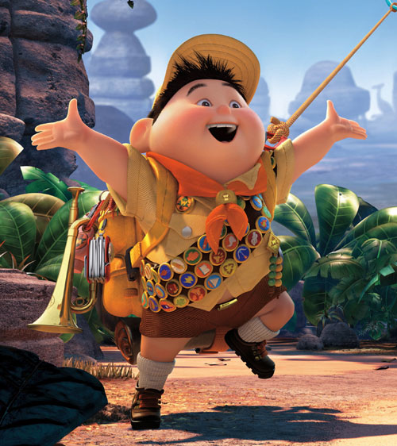
Volunteer

Slide 34
Computer
programs
How can we develop intelligent agents?
Better than
chance
As well as
humans

Slide 35
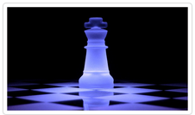
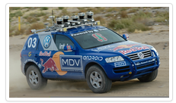

Big Milestones Starting in 1997
1997 Deep Blue
2005 Stanley
2011 Watson

Slide 36
Self Driving Cars

Slide 37
Computers Making Art

Slide 38
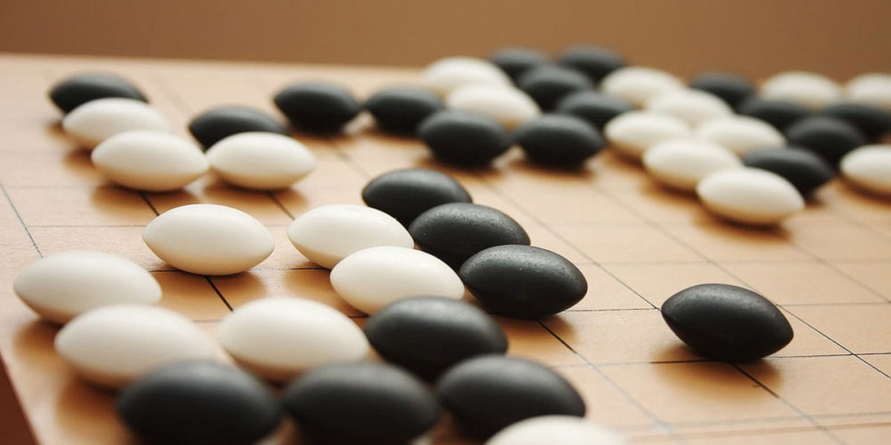
The Last Remaining Board Game

Slide 39
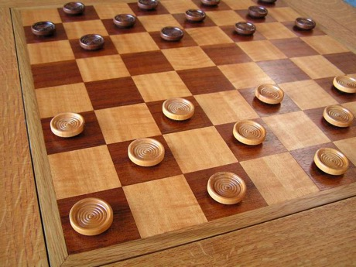
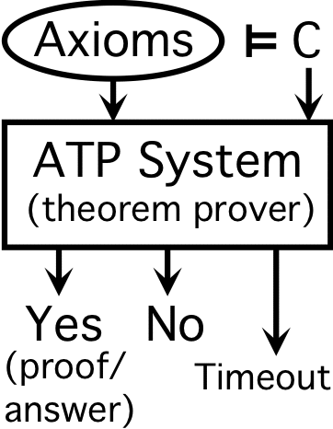
Early Optimism 1950
1952
1955

Slide 40
Early Optimism 1950
“Machines will be capable, within twenty years, of doing any work a man can do.”
–Herbert Simon, 1952

Slide 41
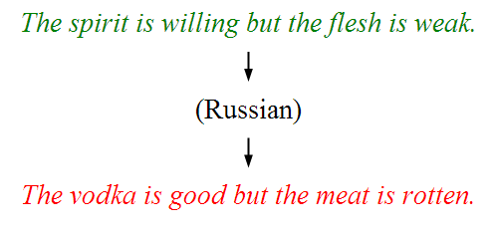
Underwhelming Results 1950s to 1980s
The world is too complex

Slide 42


Slide 43
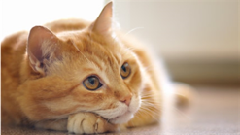
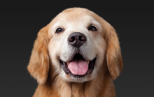
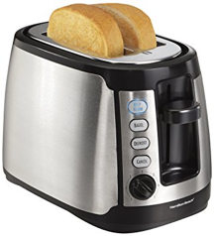
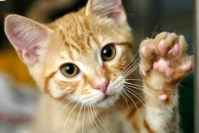
Simple Example: Identifying Cats
We have a picture and we want to know if it’s a cat or not.
true
false
true
false

Slide 44
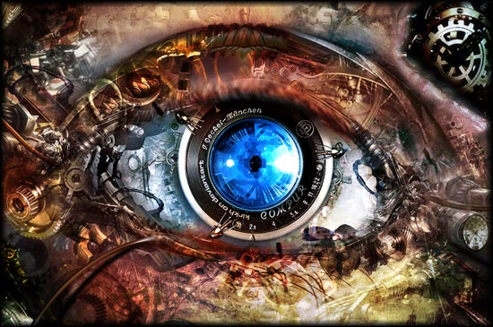


Slide 45
Identifying Cats
Here’s one way you might code this…
private void isCat(GImage animal) {
int[][] pixels = animal.getPixelArray();
if (containsTwoEyes(pixels)){
if (hasWhiskers(pixels)){
if (hasPointyEars(pixels)){
return true;
}
}
}
return false;
}

Slide 46
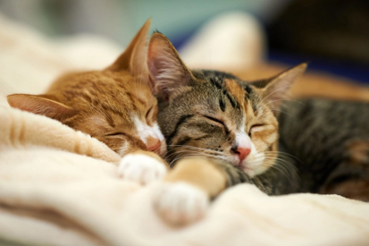

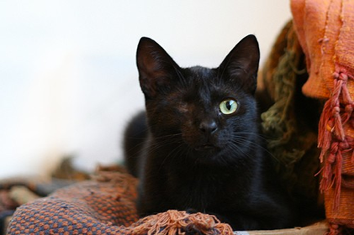
Some Tricky Cases

Slide 47
Pros / Cons
Pros
Matches our human intuition about what a cat is
Easy to understand the code
Cons
Requires us to explicitly enumerate every feature that’s important, and know how important it is
Need to write code to detect eyes, and whiskers, and the pointiness of ears
Will never improve… cannot learn from its mistakes

Slide 48
MNIST

Slide 49
Computer Vision

Slide 50

Classification
Logistic Regression is like the Harry Pottery Sorting Hat
That is a picture
of a one

Slide 51

Classification
Logistic Regression is like the Harry Pottery Sorting Hat
That is a picture
of a zero

Slide 52

Classification
That is a picture
of an zero
* It doesn’t have to be correct all of the time

Slide 53
Can you do it?

Slide 54


Slide 55


Slide 56
Four Prototypical Trajectories
Hard problems seemed impossible.

Slide 57
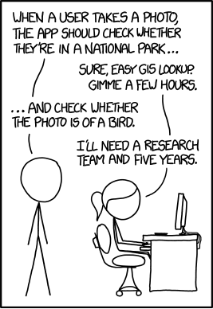
AI is Hard
Great idea #1 learn from experience

Slide 58
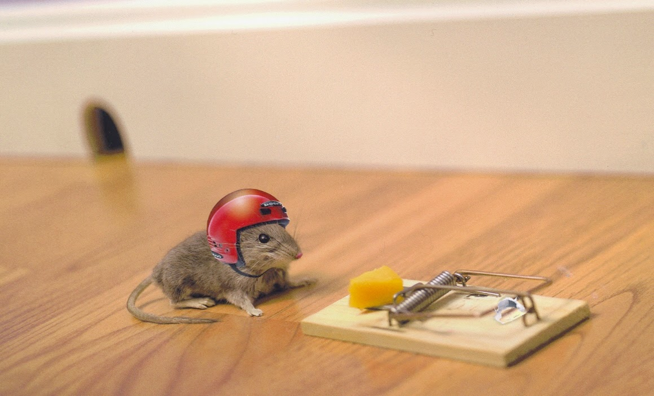
Machine Learning: Learn From Experience

Slide 59
Great idea #2 inspired by biology

Slide 60
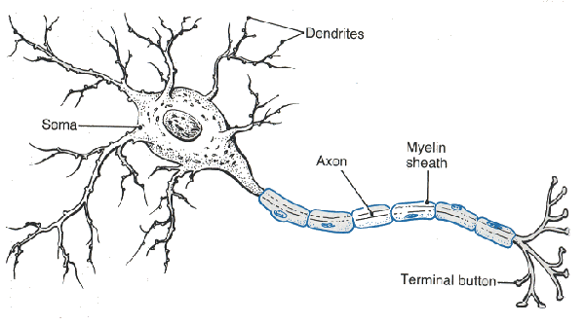
Neuron

Slide 61
Neuron

Slide 62
Neuron

Slide 63
Neuron

Slide 64
Neuron

Slide 65
Some Inputs are More Important

Slide 66

Artificial Neurons

Slide 67
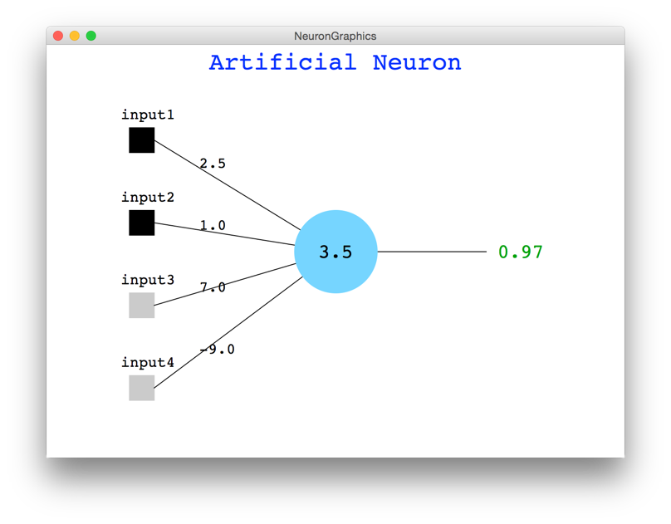
Java Demo

Slide 68
Artificial Neuron
// calculate the activation of a neuron
private double activate(double[] weights, double[] inputs) {
double weightedSum = 0;
for(int i = 0; i < inputs.length; i++) {
weightedSum += weights[i] * inputs[i];
}
return squash(weightedSum);
}
// the sigmoid function forces a value to be between 0 and 1
private double squash(double value) {
return 1 / (1 + Math.exp(-value)); }

Slide 69
MNIST

Slide 70

Digit Recognition Example
Let’s make feature vectors from pictures of numbers
input
label
input
label

Slide 71
Single Neuron
This means it predicts a 0
…

Slide 72
Single Neuron
Indicates fully connected
This means it predicts a 0
…

Slide 73
Single Neuron
This means it predicts a 1
…

Slide 74

Not So Good
This means it predicts a 1
…

Slide 75
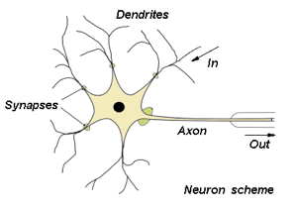
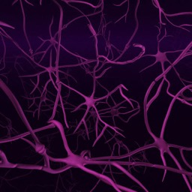
Biological Basis for Neural Networks
A neuron
Your brain
Actually, it’s probably someone else’s brain
x₁
θ₁
x₂
θ₂
y
x₃
θ₃
θ₄
x₄
x₁
x₂
x₃
x₄

Slide 76
We Can Put Neurons Together
This means it predicts a 0
…

Slide 77
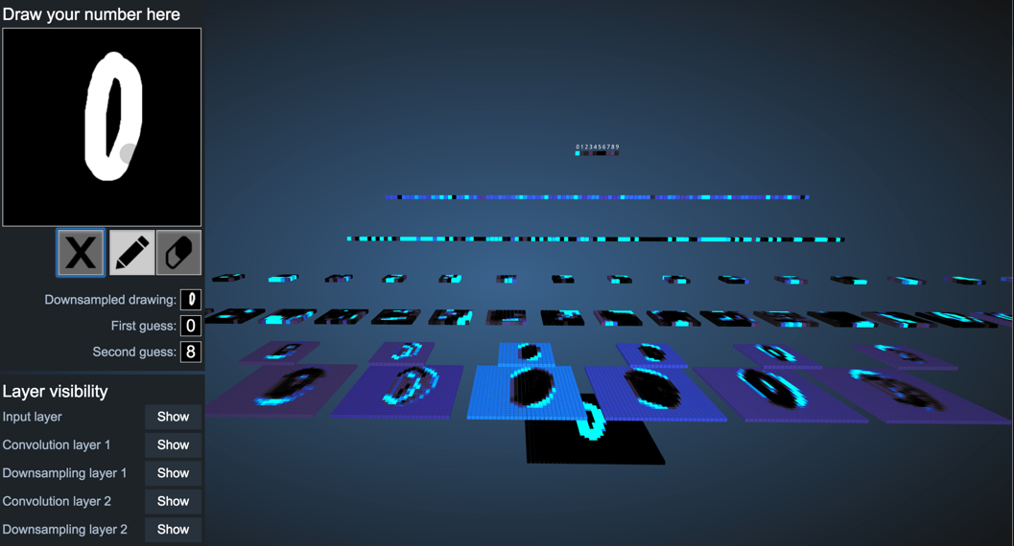
Demonstration
http://scs.ryerson.ca/~aharley/vis/conv/

Slide 78
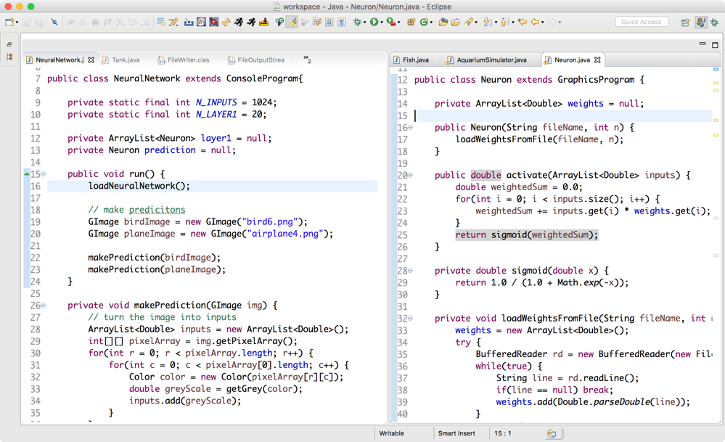
What Does This Look Like in Code?

Slide 79
Aside: decomposition

Slide 80
How do we get those weights?

Slide 81
Chain Rule Down the Network

Slide 82
Learning Weights
Notes:
LL(\theta) = y \log \sigma(\theta^T \mathbf{x}) + (1-y) \log [1 - \sigma(\theta^T \mathbf{X})

Slide 83
Artificial Neurons: One of the greatest decompositions of our lifetimes

Slide 84
model.calculatePartialDerivative(data)

Slide 85
model.update(data)

Slide 86
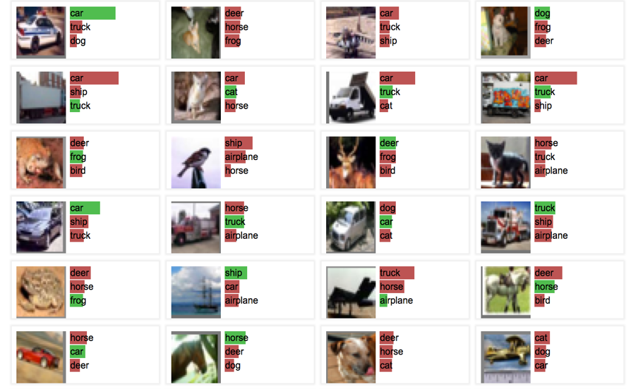
Let’s Train!
http://cs.stanford.edu/people/karpathy/convnetjs/demo/classify2d.html

Slide 87
Like lego pieces

Slide 88
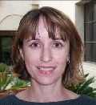

Visualize the Weights
object models
object parts
(combination
of edges)
Training set: Aligned
images of faces.
edges
pixels
[Honglak Lee]

Slide 89

GoogLeNet Brain
1 Trillion Artificial Neurons

Slide 90
GoogLeNet Brain Graph
Multiple,
Multi class output
22 layers deep

Slide 91
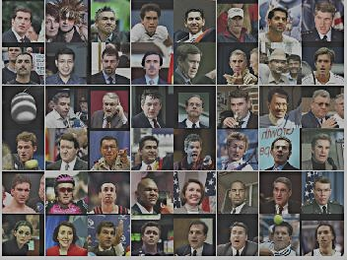
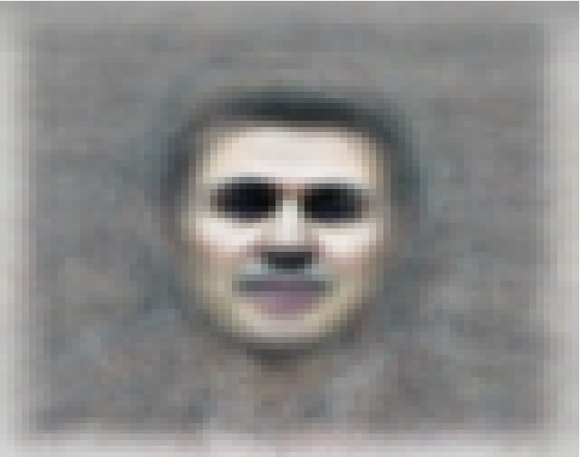
The Face Neuron
Top stimuli from the test set
Optimal stimulus
by numerical optimization
Le, et al., Building high-level features using large-scale unsupervised learning. ICML 2012

Slide 92
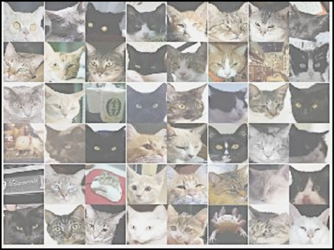
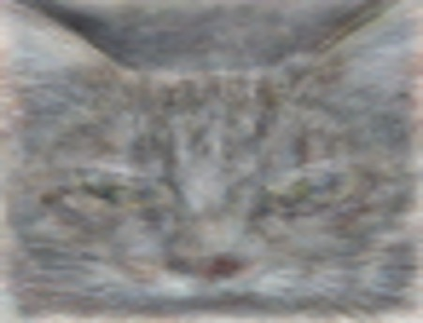
The Cat Neuron
Top stimuli from the test set
Optimal stimulus
by numerical optimization
Le, et al., Building high-level features using large-scale unsupervised learning. ICML 2012

Slide 93
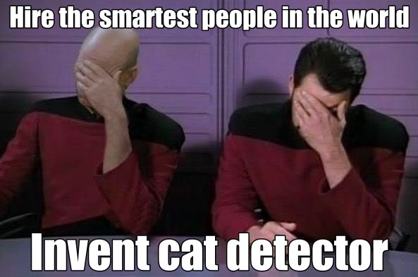

Slide 94

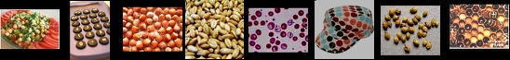
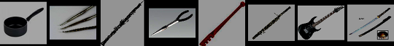

Best Neuron Stimuli
Neuron 1
Neuron 2
Neuron 3
Neuron 4
Neuron 5
Le, et al., Building high-level features using large-scale unsupervised learning. ICML 2012
Input to another layer above
(image with 8 channels)
Number of output
channels = 8
LCN Size = 5
H
Pooling Size = 5
Number
of maps = 8
One layer
W
RF size = 18
Number of input
channels = 3
Image Size = 200

Slide 95




Best Neuron Stimuli
Neuron 6
Neuron 7
Neuron 8
Neuron 9
Le, et al., Building high-level features using large-scale unsupervised learning. ICML 2012
Input to another layer above
(image with 8 channels)
Number of output
channels = 8
LCN Size = 5
H
Pooling Size = 5
Number
of maps = 8
One layer
W
RF size = 18
Number of input
channels = 3
Image Size = 200

Slide 96
ImageNet Classification
22,000 categories
14,000,000 images
Hand-engineered features (SIFT, HOG, LBP),
Spatial pyramid, SparseCoding/Compression
Le, et al., Building high-level features using large-scale unsupervised learning. ICML 2012

Slide 97
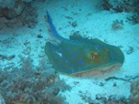
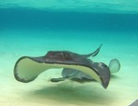
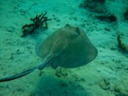
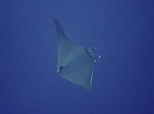
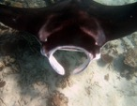
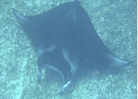
22,000 is a lot!
…
smoothhound, smoothhound shark, Mustelus mustelus
American smooth dogfish, Mustelus canis
Florida smoothhound, Mustelus norrisi
whitetip shark, reef whitetip shark, Triaenodon obseus
Atlantic spiny dogfish, Squalus acanthias
Pacific spiny dogfish, Squalus suckleyi
hammerhead, hammerhead shark
smooth hammerhead, Sphyrna zygaena
smalleye hammerhead, Sphyrna tudes
shovelhead, bonnethead, bonnet shark, Sphyrna tiburo
angel shark, angelfish, Squatina squatina, monkfish
electric ray, crampfish, numbfish, torpedo
smalltooth sawfish, Pristis pectinatus
guitarfish
roughtail stingray, Dasyatis centroura
butterfly ray
eagle ray
spotted eagle ray, spotted ray, Aetobatus narinari
cownose ray, cow-nosed ray, Rhinoptera bonasus
manta, manta ray, devilfish
Atlantic manta, Manta birostris
devil ray, Mobula hypostoma
grey skate, gray skate, Raja batis
little skate, Raja erinacea
…
Stingray
Mantaray

Slide 98
0.005%
1.5%
?
Random guess
Pre Neural Networks
GoogLeNet
Le, et al., Building high-level features using large-scale unsupervised learning. ICML 2012

Slide 99
0.005%
1.5%
43.9%
Random guess
Pre Neural Networks
GoogLeNet
Szegedy et al, Going Deeper With Convolutions, CVPR 2015

Slide 100
0.005%
1.5%
82.7%
Random guess
Pre Neural Networks
NASNet
https://arxiv.org/pdf/1707.07012.pdf

Slide 101
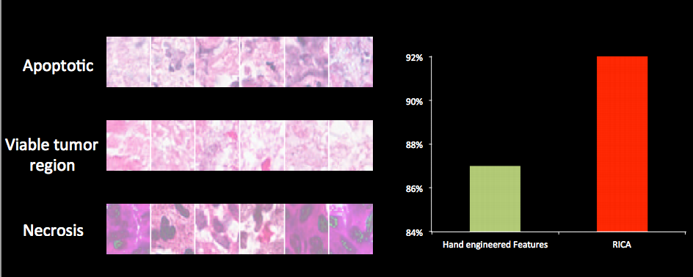
Vision has Social Implications
Neural network

Slide 102
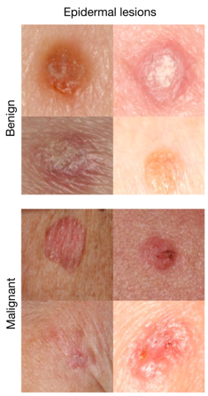
Where is this useful?
A machine learning algorithm performs better than the best dermatologists.
Developed this year, at Stanford.
Esteva, Andre, et al. "Dermatologist-level classification of skin cancer with deep neural networks." Nature 542.7639 (2017): 115-118.
Esteva et al., Nature 2017.

Slide 103
http://sustain.stanford.edu/
http://sustain.stanford.edu/
http://sustain.stanford.edu/

Slide 104

Understanding Students
Huge improvement in ability to predict for real students

Slide 105
Tl;dr our brain is constantly decomposing

Slide 106
Told Vision Was 30 Years Out

Slide 107
Told Speech Was 30 Years Out
Almost perfect…

Slide 108
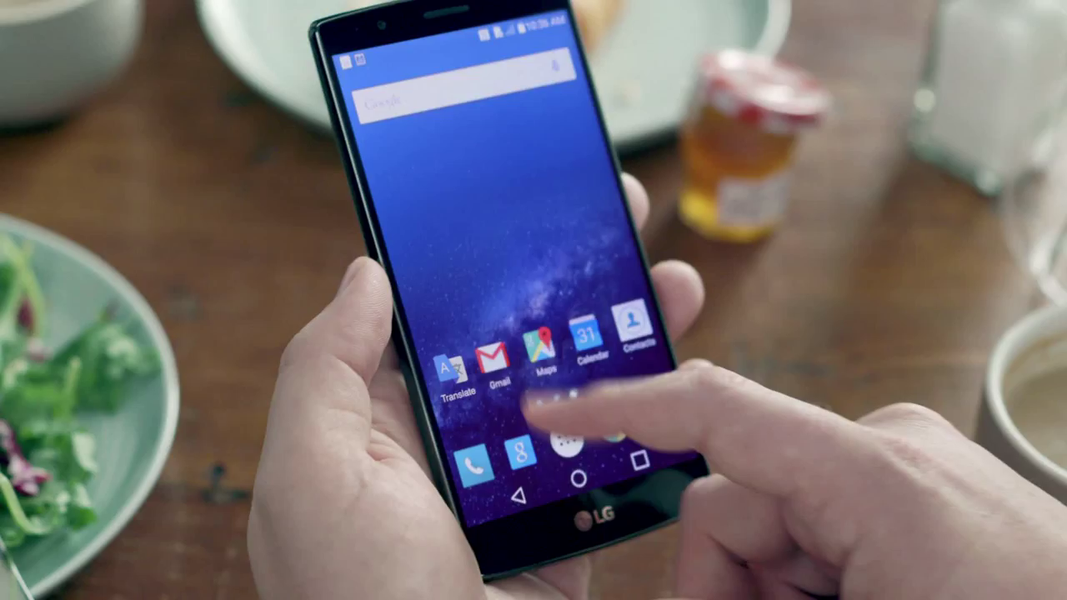
What a time to be alive

Slide 109
Ethics in AI

Slide 110
The end

Slide 111
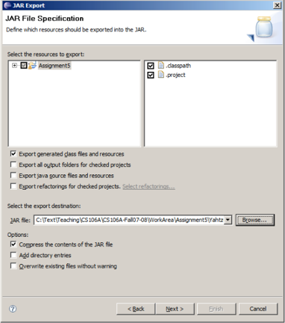
Export to JAR
JAR: Java Archive. A compressed binary of a Java program.
The typical way to distribute a Java app as a single file.
Essentially just a ZIP file with Java .class files in it.
Making a JAR of your project in Eclipse:
File → Export ... → Java → Runnable JAR File
see handout on course web site

